Slide 1
Open Source SDKs for Quantum Computing
There are several open-source SDKs (Software Development Kits) available for quantum computing, each designed to help developers and researchers build, test, and run quantum algorithms on various quantum hardware and simulators.

Slide 2
Open Source SDKs for Quantum Computing
Sl.NO | SDK | Developer | Language
1 | Qiskit | IBM Research and the Qiskit community. | Python
2 | Cirq | Google | Python
3 | Braket | Amazon | Python
4 | Forest | Rigetti Computing | Python
5 | Ocean | D-Wave Systems. | Python
6 | ProjectQ | ETH Zurich | Python
7 | QDK | Microsoft | Q#
Others : Strawberry Fields (Xanadu)(Python), Quipper (Haskel), PennyLane(Python),etc.

Slide 3
Qiskit Key Features
Components: Includes
Terra[ Earth] : circuit construction
Aer [ Air] : simulation,
Ignis [Fire ] : error mitigation, and
Aqua [Water] : application-specific algorithms.
Ecosystem: Supports a wide range of quantum algorithms and applications, including finance, chemistry, and machine learning.
Community: Strong community support with extensive tutorials and resources.
Use Cases: Suitable for both beginners and advanced users, enabling access to IBM's quantum hardware and simulators.

Slide 4
Installing Qiskit
pip install qiskit
[ This This will install the latest stable version of Qiskit, including: Qiskit Terra, Qiskit Aer, Qiskit Ignis and Qiskit Aqua]
Upgrading qistkit: pip install --upgrade qiskit
Installing Individual Components
pip install qiskit-terra
pip install qiskit-aer
pip install qiskit-ignis
pip install qiskit-aqua

Slide 5
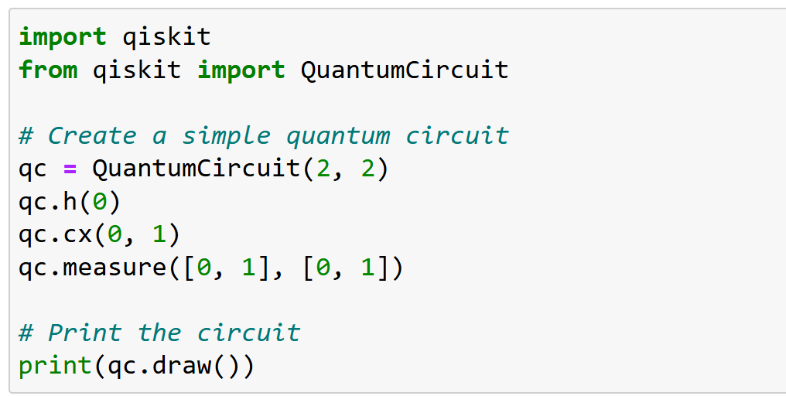
Verifying the Installation

Slide 6
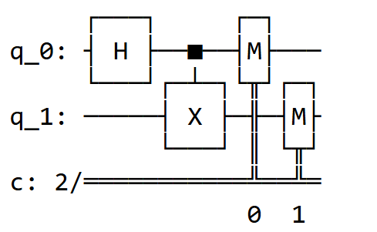
Verifying the Installation

Slide 7
Qiskit Python Programs to representing Single Qubit States
|0⟩ state
|1⟩ state
|i⟩ state
|-i⟩ state
|+⟩ state
|-⟩ state

Slide 8
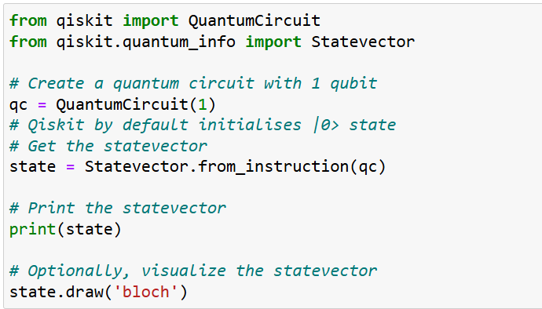
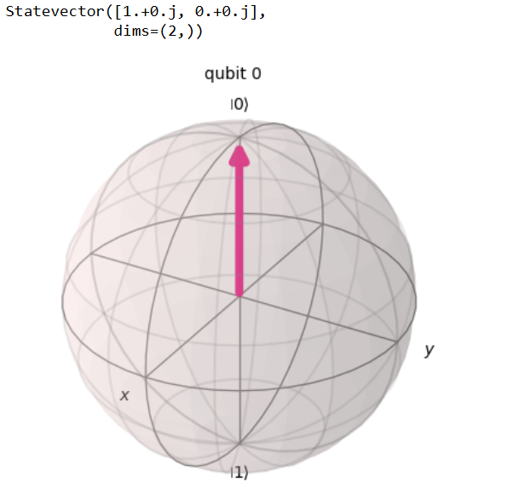
1. Qiskit Python program to represent the |0⟩ state vector

Slide 10
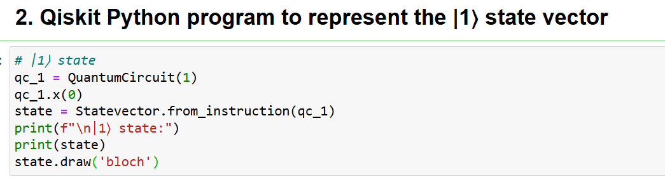
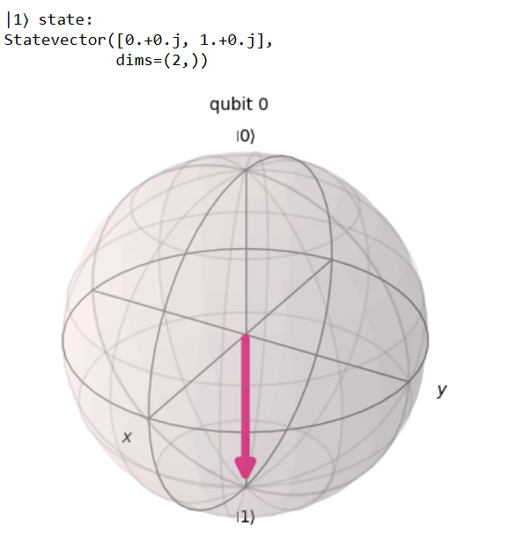

Slide 11
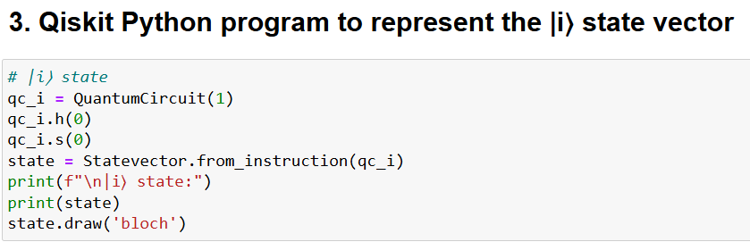
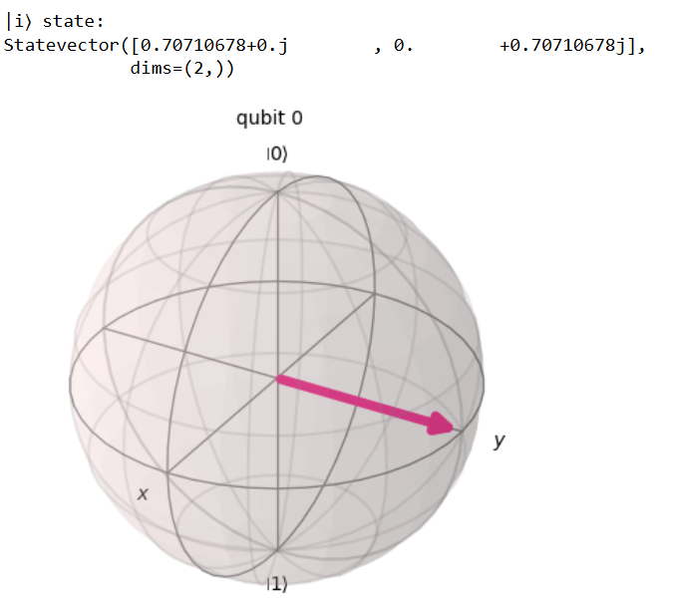

Slide 12
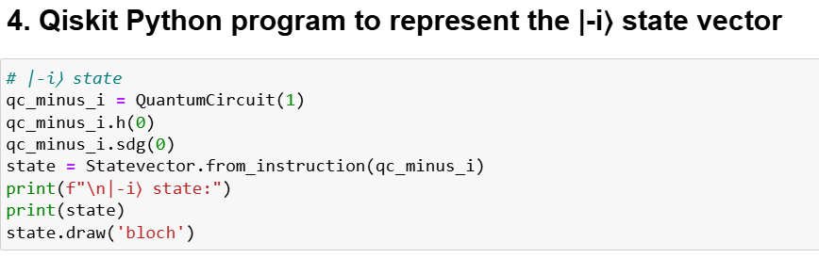
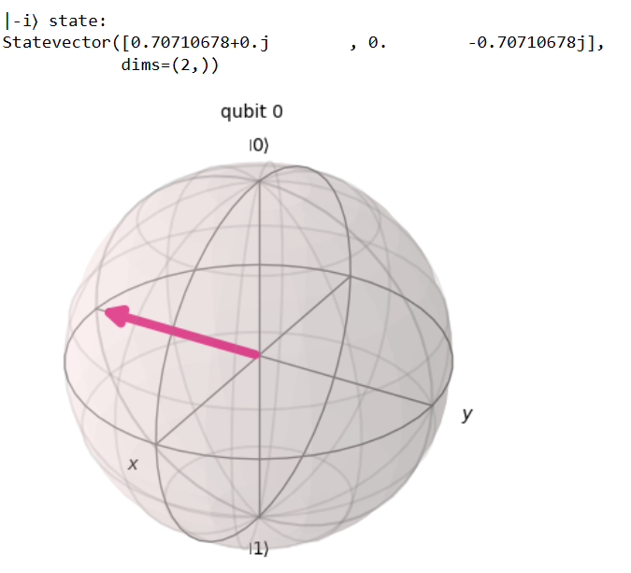

Slide 13
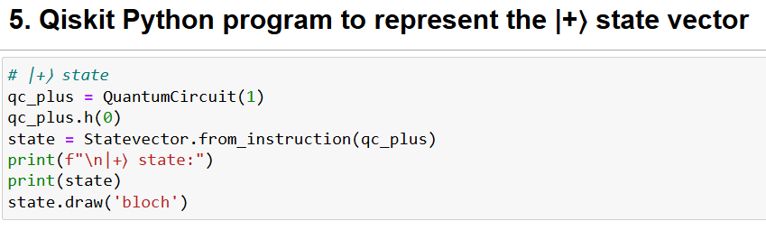
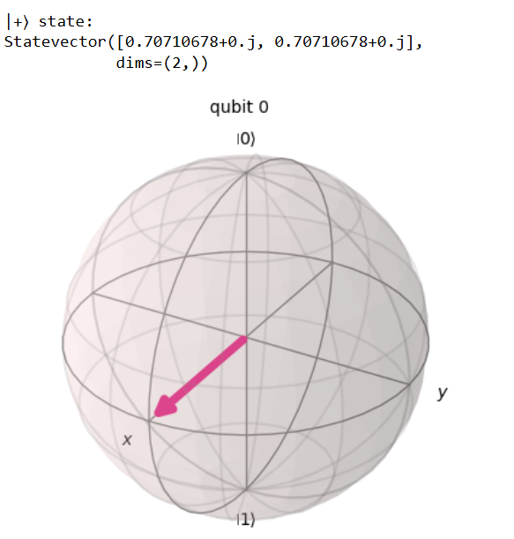

Slide 14
